Slide 1
Deep Neural Networks for Sequential Data
CS771: Introduction to Machine Learning
Piyush Rai

Slide 2
Plan Today
2
Batch-normalization and Dropout layers
Deep Neural Networks for sequential data (e.g., text)
Recurrent Neural Networks and variants
CNNs for text
Attention mechanism

Slide 3
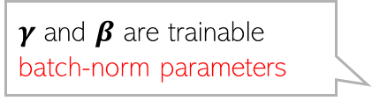
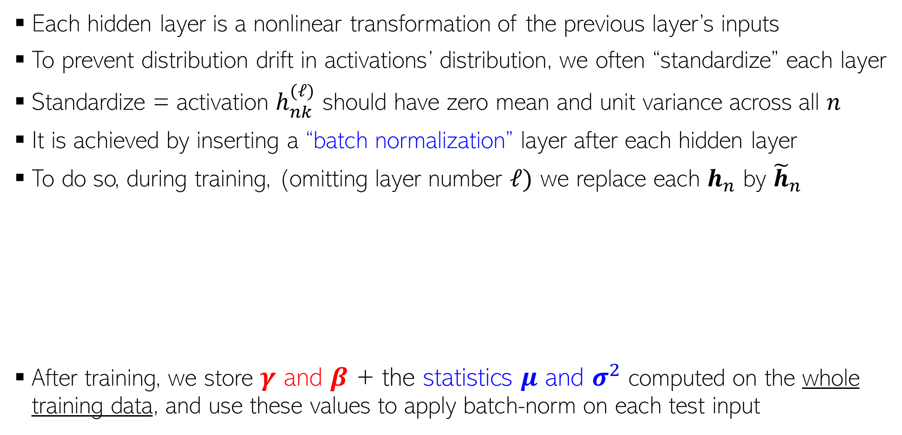
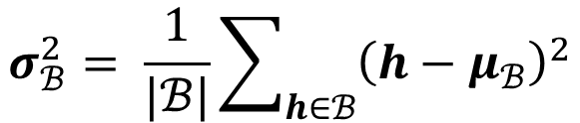
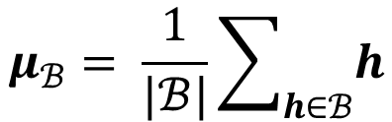

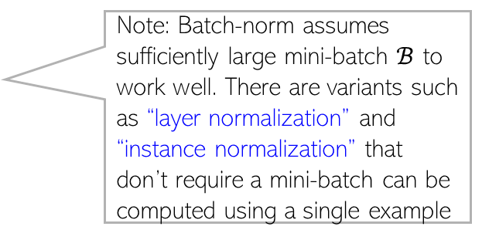

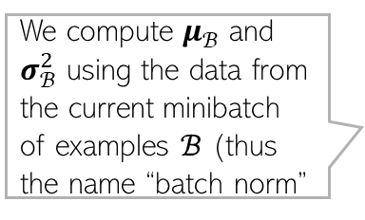
Recap: Normalization Layer
3
Each hidden layer is a nonlinear transformation of the previous layer’s inputs
To prevent distribution drift in activations’ distribution, we often “standardize” each layer
Standardize = activation $h_{nk}^{(ℓ)}$ should have zero mean and unit variance across all $n$
It is achieved by inserting a “batch normalization” layer after each hidden layer
To do so, during training, (omitting layer number $ℓ)$ we replace each $h_{n}$ by ${\tilde{h}}_{n}$
After training, we store $γ$ and $β$ + the statistics $μ$ and $σ^{2}$ computed on the whole training data, and use these values to apply batch-norm on each test input
$γ$ and $β$ are trainable batch-norm parameters
Note: Batch-norm assumes sufficiently large mini-batch $ℬ$ to work well. There are variants such as “layer normalization” and “instance normalization” that don’t require a mini-batch can be computed using a single example
$${\hat{h}}_{n}= \frac{h_{n} −μ_{ℬ}}{\sqrt{σ_{ℬ}^{2}+ε}}$$
$${\tilde{h}}_{n}=γ⊙ {\hat{h}}_{n}+β$$
We compute $μ_{ℬ}$ and $σ_{ℬ}^{2}$ using the data from the current minibatch of examples $ℬ$ (thus the name “batch norm”
$$μ_{ℬ}= \frac{1}{|ℬ|}\sum_{h∈ℬ}{h}$$
$$σ_{ℬ}^{2}= \frac{1}{|ℬ|}\sum_{h∈ℬ}{{\left(h−μ_{ℬ}\right)}^{2}}$$

Slide 4
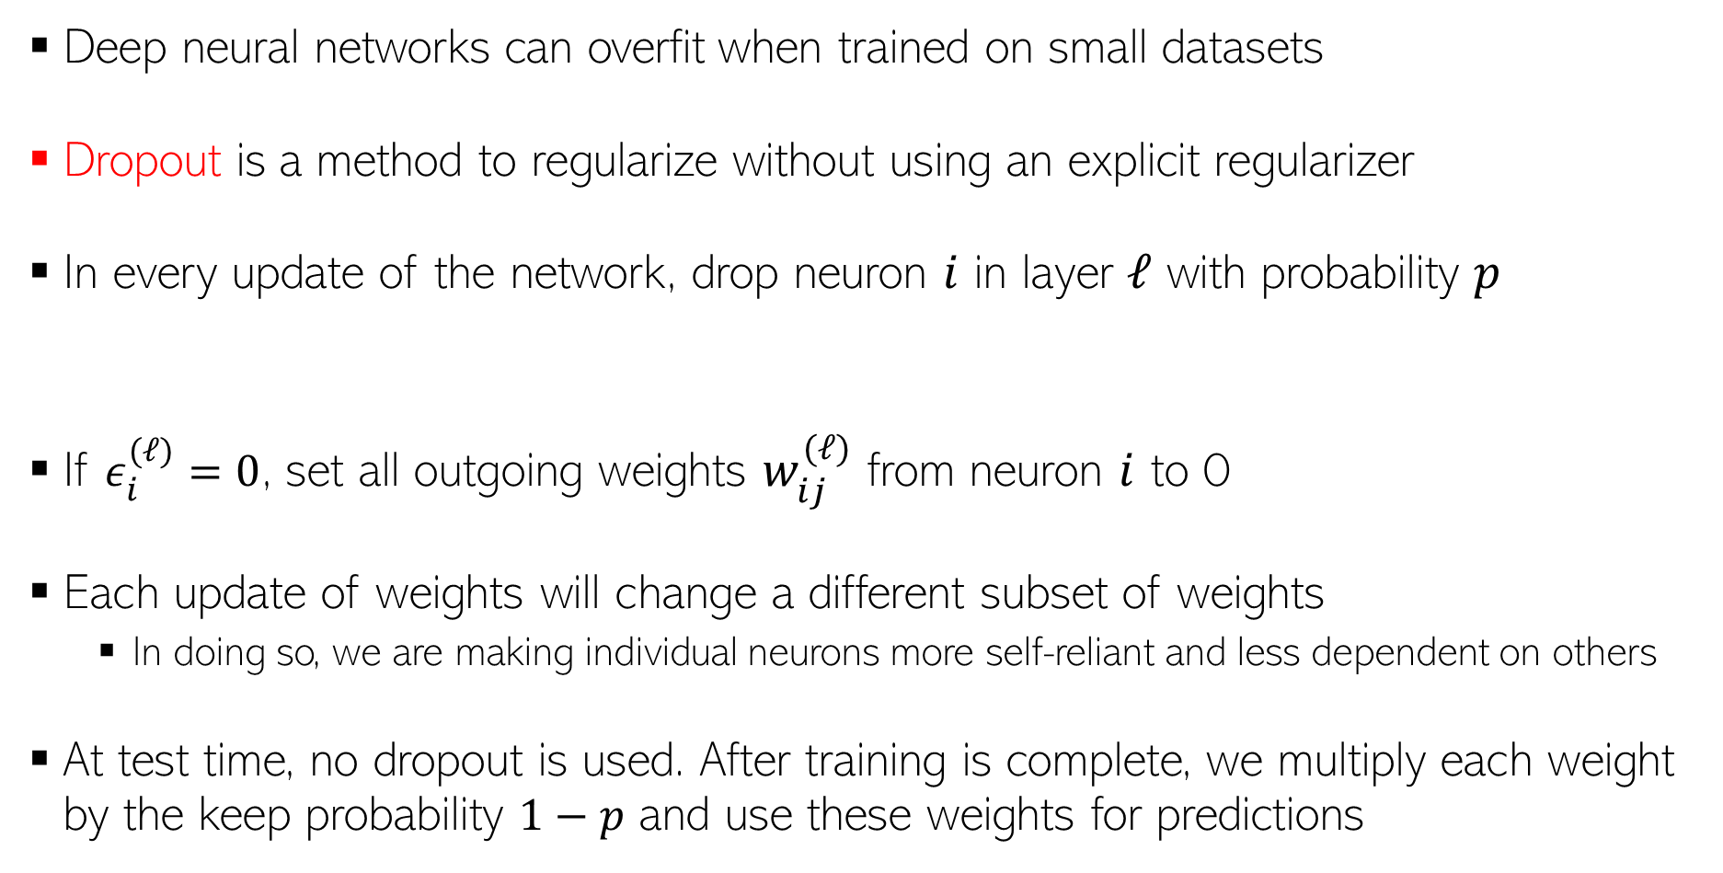

Dropout Layer
4
Deep neural networks can overfit when trained on small datasets
Dropout is a method to regularize without using an explicit regularizer
In every update of the network, drop neuron $i$ in layer $ℓ$ with probability $p$
If $ε_{i}^{(ℓ)}=0$, set all outgoing weights $w_{ij}^{(ℓ)}$ from neuron $i$ to 0
Each update of weights will change a different subset of weights
In doing so, we are making individual neurons more self-reliant and less dependent on others
At test time, no dropout is used. After training is complete, we multiply each weight by the keep probability $1−p$ and use these weights for predictions
$$ε_{i}^{(ℓ)}∼Bernoulli(1−p)$$

Slide 5
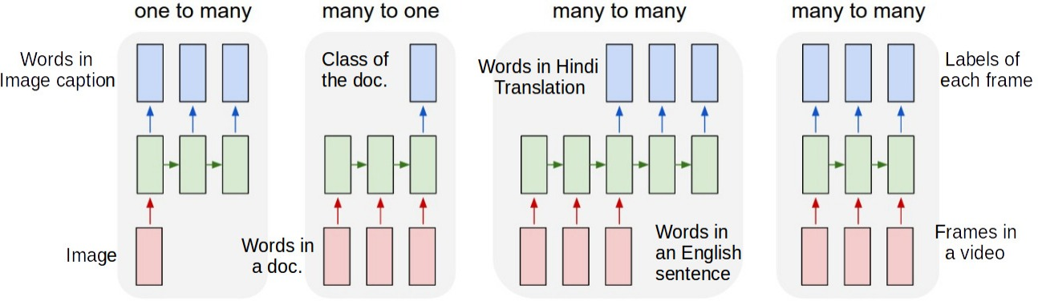
Sequential Data
5
In many problems, each input, each output, or both may be in form of sequences
Different inputs or outputs need not have the same length
Some examples of prediction tasks in such problems
Image captioning: Input is image (not a sequence), output is the caption (word sequence)
Document classification: Input is a word sequence, output is a categorical label
Machine translation: Input is a word sequence, output is a word sequence (in different language)
Stock price prediction: Input is a sequence of stock prices, output is its predicted price tomorrow
No input – just output (e.g., generation of random but plausible-looking text)
These green cells are some feature representation (e.g., hidden layer of a deep neural network) of the inputs

Slide 6


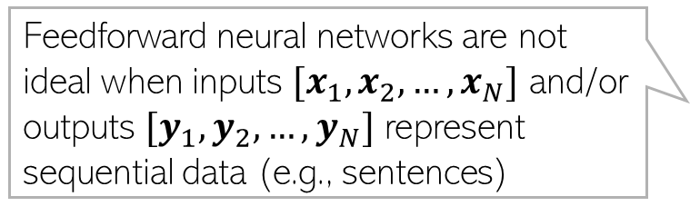



























































Recurrent Connections in Deep Neural Networks
6
Feedforward nets such as MLP and CNN assume independent observations
A recurrent structure can be helpful if each input and/or output is a sequence
$$y_{1}$$
$$y_{2}$$
$$y_{n}$$
$y_{n}$ depends only on $h_{n}$
$$y_{N}$$
$$v$$
$$v$$
$$v$$
$h_{n}$ depends only on $x_{n}$
$$v$$
Feedforward neural networks are not ideal when inputs $[x_{1},x_{2},…, x_{N}]$ and/or outputs $[y_{1},y_{2},…, y_{N}]$ represent sequential data (e.g., sentences)
$$h_{1}$$
$$h_{2}$$
$$h_{n}$$
$$h_{N}$$
$$W$$
$$W$$
$$W$$
$$W$$
$$x_{1}$$
$$x_{2}$$
$$x_{n}$$
$$x_{N}$$
$$y_{1}$$
$$y_{2}$$
$$y_{3}$$
$$y_{n}$$
$$y_{N}$$
Corresponding output (assuming same length as the input)
$$y_{n}$$
$$v$$
$$v$$
$$v$$
$$v$$
$$v$$
Compactly
$$v$$
$$h_{1}$$
$$U$$
$$h_{2}$$
$$U$$
$$h_{3}$$
$$U$$
$$U$$
$$h_{n}$$
$$U$$
$$U$$
$$h_{N}$$
$$h_{n}$$
$$U$$
$$W$$
$$W$$
$$W$$
$$W$$
$$W$$
$$W$$
A single input of length $N$
$$x_{n}$$
$$x_{1}$$
$$x_{2}$$
$$x_{3}$$
$$x_{n}$$
$$x_{N}$$

Slide 7
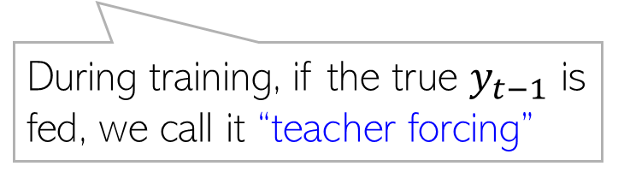


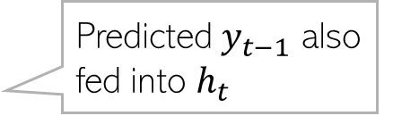
Recurrent Neural Networks: Some Examples
7
Consider generating a sequence $y_{1},y_{2},…, y_{T}$ given an input $x$
Predicting the sentiment of a movie review
Words in the generated caption
At test time, we can only feed the predicted $y_{t−1}$
Predicted $y_{t−1}$ also fed into $h_{t}$
Hidden states at each step of the sequence
During training, if the true $y_{t−1}$ is fed, we call it “teacher forcing”
An image
This final hidden state is supposed to contain the information about the entire review
Isn’t this too much to expect?? ☺
Hidden states
Indeed; this can be an issue with RNNs
Predicted sentiment
Words in the review

Slide 8
Recurrent Neural Networks: Some Examples
8
Parts of speech tagging (or “aligned” translation; input and output have same length)
“Unaligned” translation (input and output can have different lengths)
In the unaligned case, generation stops when an “end” token (e.g., <END>) is generated on the output side
Parts of speech tag for each word
Words in a sentence
Such problems usually require a sequence encoder- sequence decoder architecture
Encode the input sequence into an embedding vector and then decode this embedding one output token at a time

Slide 9







Recurrent Neural Networks: Some Examples
9
Unconditional generation (no input, only an output sequence is generated given a RNN that was trained using some training data containing several sequences)
Each generate word/token is fed to the next step’s hidden state
Generation stops when an “end” token (e.g., <END>) is generated
$$y_{1}$$
$$y_{2}$$
$$y_{3}$$
$$h_{1}$$
$$h_{2}$$
$$h_{3}$$
“Seed” token, e.g, <START>
$$s_{0}$$

Slide 10






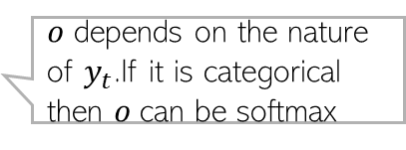




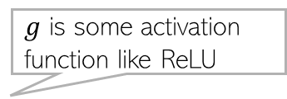




























Recurrent Neural Networks
10
A basic RNN’s architecture (assuming input and output sequence have same lengths)
RNN has three sets of weights $W,U,v$
$W$ and $U$ model how $h_{t}$ at step t is computed: $h_{t}=g(Wx_{t}+ Uh_{t−1})$
$v$ models the hidden layer to output mapping, e.g., $y_{t}=o(vh_{t})$
Important: Same $W,U,v$ are used at all steps of the sequence (weight sharing)
$$y_{1}$$
$$y_{2}$$
$$y_{3}$$
$$y_{t}$$
$$y_{T}$$
$$y_{t}$$
$$v$$
$$v$$
$$v$$
$$v$$
$$v$$
Compactly
$$v$$
$$h_{1}$$
$$U$$
$$h_{2}$$
$$U$$
$$h_{3}$$
$$U$$
$$U$$
$$h_{t}$$
$$U$$
$$U$$
$$h_{T}$$
$$h_{t}$$
$$U$$
$$W$$
$$W$$
$$W$$
$$W$$
$$W$$
$$W$$
$$x_{1}$$
$$x_{2}$$
$$x_{3}$$
$$x_{t}$$
$$x_{T}$$
$$x_{t}$$
$g$ is some activation function like ReLU
$o$ depends on the nature of $y_{t}$.If it is categorical then $o$can be softmax

Slide 11






































For RNNs, Long Distant Past is Hard to Remember
11
The hidden layer nodes $h_{t}$ are supposed to summarize the past up to time $t−1$
In theory, they should. In practice, they can’t. Some reasons
Vanishing gradients along the sequence too – past knowledge gets “diluted”
Hidden nodes also have limited capacity because of their finite dimensionality
Various extensions of RNNs have been proposed to address forgetting
Gated Recurrent Units (GRU), Long Short Term Memory (LSTM)
$$y_{1}$$
$$y_{2}$$
$$y_{3}$$
$$y_{t}$$
$$y_{T}$$
$$y_{t}$$
$$v$$
$$v$$
$$v$$
$$v$$
$$v$$
Compactly
$$v$$
$$h_{1}$$
$$U$$
$$h_{2}$$
$$U$$
$$h_{3}$$
$$U$$
$$U$$
$$h_{t}$$
$$U$$
$$U$$
$$h_{T}$$
$$h_{t}$$
$$U$$
$$W$$
$$W$$
$$W$$
$$W$$
$$W$$
$$W$$
$$x_{1}$$
$$x_{2}$$
$$x_{3}$$
$$x_{t}$$
$$x_{T}$$
$$x_{t}$$

Slide 12
GRU and LSTM
12
GRU and LSTM are variants of RNNs. These contain specialized units and “memory” which modulate what/how much information from the past to retain/forget

Slide 13
Bidirectional RNN
13
RNNs and GRU and LSTM only remember the information from the previous tokens
Bidirectional RNNs can remember information from the past and future tokens
Embeddings that take information from both directions (depend on forward and reverse direction embeddings)
Reverse direction embeddings of input tokens
Forward direction embeddings of input tokens

Slide 14
CNN for Text
14
CNNs can exploit sequential structure as well using convolutions
Figure below is CNN for text data where the goal is to predict sentiment of a review
Convolutions applied using several filters of different lengths (e.g., 2, 4, etc)
Filter of length 2
Filter of length 4
Each word has been embedded using a word embedding layer to give a vector representation for the word
Can think of each dimension of the word embedding as a different “channel” of the inputs

Slide 15

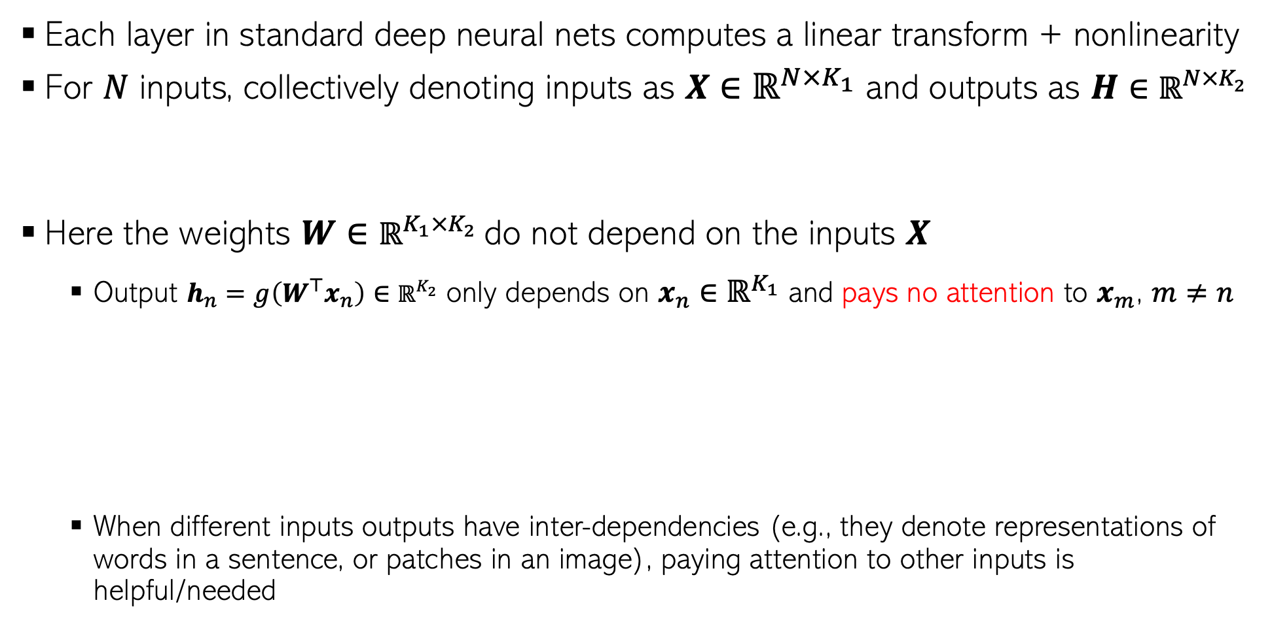








Need for Attention
15
Each layer in standard deep neural nets computes a linear transform + nonlinearity
For $N$ inputs, collectively denoting inputs as $X∈ℝ^{N×K_{1}}$ and outputs as $H∈ℝ^{N×K_{2}}$
Here the weights $W∈ℝ^{K_{1}×K_{2}}$do not depend on the inputs $X$
Output $h_{n}=g\left(W^{⊤}x_{n}\right)∈ℝ^{K_{2}}$ only depends on $x_{n}∈ℝ^{K_{1}}$ and pays no attention to $x_{m}$, $m≠n$
When different inputs outputs have inter-dependencies (e.g., they denote representations of words in a sentence, or patches in an image), paying attention to other inputs is helpful/needed
$$H=g(XW)$$
Notation alert: Input $X$ can be data (if $H$ denotes first hidden layer) or the $H$ of the previous hidden layer
$$h_{n}$$
$$W$$
$$x_{1}$$
$$x_{n−1}$$
$$x_{n}$$
$$x_{n+1}$$
$$x_{N}$$

Slide 16

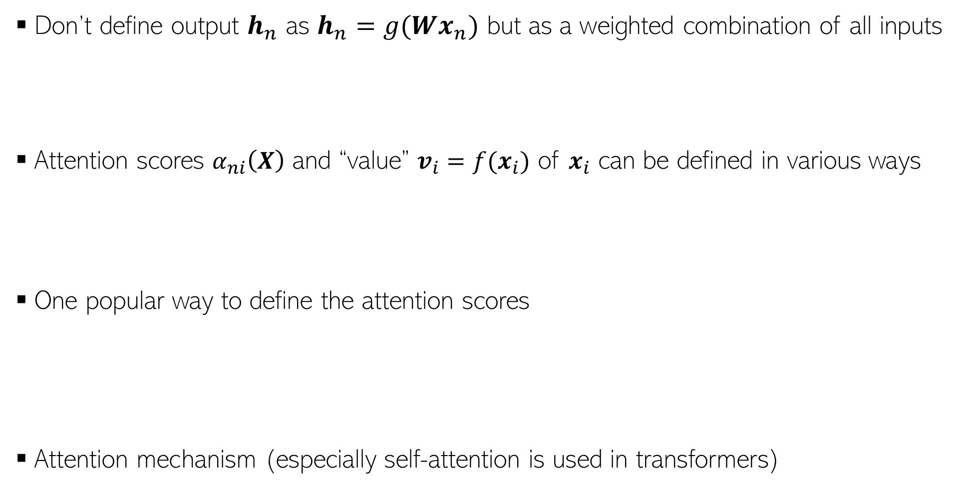

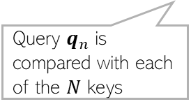
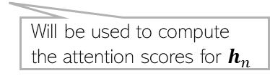
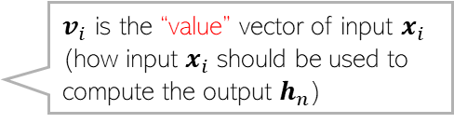





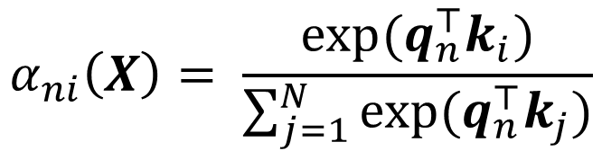

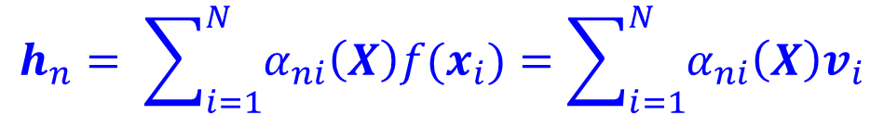
Attention Mechanism
16
Don’t define output $h_{n}$ as $h_{n}=g(Wx_{n})$ but as a weighted combination of all inputs
Attention scores $α_{ni}\left(X\right)$ and “value” $v_{i}=f(x_{i})$ of $x_{i}$ can be defined in various ways
One popular way to define the attention scores
Attention mechanism (especially self-attention is used in transformers)
$α_{ni}$ is the attention score(to be learned) which tells us how much input $x_{i}$ should attend to output $h_{n}$
$v_{i}$ is the “value” vector of input $x_{i}$ (how input $x_{i}$ should be used to compute the output $h_{n}$)
$$h_{n}= \sum_{i=1}^{N}{α_{ni}\left(X\right)f(x_{i})}=\sum_{i=1}^{N}{α_{ni}\left(X\right)v_{i}}$$
$N×K$matrix of “queries”
$N×K$matrix of $N$ “keys”
$N×K$matrix of “value” vectors of the $N$ keys
$$Q=XW_{Q}$$
$$K=XW_{K}$$
$$V=XW_{V}$$
Row $n$ is $q_{n}$
Query $q_{n}$ is compared with each of the $N$ keys
Will be used to compute the attention scores for $h_{n}$
$$α_{ni}\left(X\right)= \frac{exp(q_{n}^{⊤}k_{i})}{\sum_{j=1}^{N}{exp(q_{n}^{⊤}k_{j})}}$$

Slide 17



















Attention Mechanism
17
$$h_{n}$$
$$α_{n,n+1}$$
$$α_{n,n−1}$$
$$α_{n,n}$$
$$q_{n−1}$$
$$v_{n−1}$$
$$k_{n−1}$$
$$q_{n}$$
$$v_{n}$$
$$k_{n}$$
$$q_{n+1}$$
$$v_{n+1}$$
$$k_{n+1}$$
$$x_{n−1}$$
$$x_{n}$$
$$x_{n+1}$$
$$Q=XW_{Q}$$
$$K=XW_{K}$$
$$V=XW_{V}$$

